Slide 1
Advanced Wastewater Treatment

Slide 2
Common contaminants and their treatments
Removal of residual nutrients
Removal of total dissolved solids
Removal of pathogens
Filtration
Adsorption
P and N removal

Slide 3
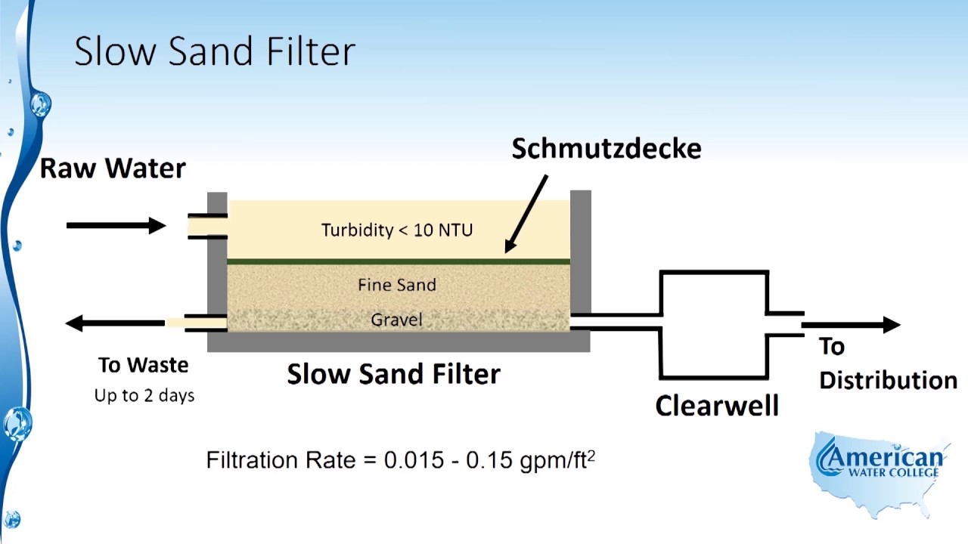
Slow Sand Filtration
A well-designed and properly maintained slow sand filter (SSF) effectively removes turbidity and pathogenic organisms through various biological, physical and chemical processes in a single treatment step.

Slide 4
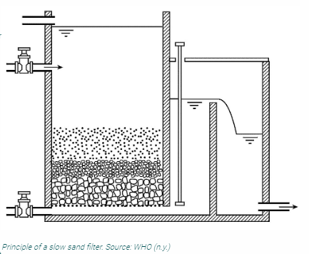
The basic principle of the process is very simple. Contaminated freshwater flows through a layer of sand, where it not only gets physically filtered but biologically treated. Hereby, both sediments and pathogens are removed. This process is based on the ability of organisms to remove pathogens.
In this context, it is important to distinguish slow and rapid sand filtration. The difference between the two is not simply a matter of the filtration speed, but of the underlying concept of the treatment process. Slow sand filtration is essentially a biological process whereas rapid sand filtration is a physical treatment process (WHO).
Advantages
Very effective removal of bacteria, viruses, protozoa, turbidity and heavy metals in contaminated fresh water
Simplicity of design and high self-help compatibility: construction, operation and maintenance only require basic skills and knowledge and minimal effort
If constructed with gravity flow only, no (electrical) pumps required
Local materials can be used for construction
High reliability and ability to withstand fluctuations in water quality
No necessity for the application of chemicals
Easy to install in rural, semi-urban and remote areas, Simplicity of design and operation
Long lifespan (estimated >10 years)

Slide 5
Although the physical removal of sediments is an important part of the purification process, the relevant aspect is the biological filtration. The top layers of the sand become biologically active by the establishment of a microbial community on the top layer of the sand substrate, also referred to as ‘schmutzdecke’.
These microbes usually come from the source water and establish a community within a matter of a few days. The fine sand and slow filtration rate facilitate the establishment of this microbial community. The majority of the community are predatory bacteria that feed on water-borne microbes passing through the filter (WHO). Hence, the underlying principle of the SSF is equivalent to the bio-sand filtration.
Disadvantages
Minimal quality and constant flow of fresh water required: turbidity (<10-20 NTU) and low algae contamination. Otherwise, pre-treatment may be necessary
Cold temperatures lower the efficiency of the process due to a decrease in biological activity
Loss of productivity during the relatively long filter skimming and ripening periods
Very regular maintenance essential; some basic equipment or ready-made test kits required to monitor some physical and chemical parameters
Possible need for changes in attitude (belief that water that flows through a green and slimy filter is safe to drink without the application of chemicals), Chemical compounds (e.g. fluorine) are not removed
Natural organic matter and other DBPs precursors not removed (may be formed if chlorine is applied for final disinfection)
May require electricity
Requirement of a large land area, large quantities of filter media and manual labour for cleaning, Low filtration rate

Slide 6
Carbon adsorption
The treatment of wastewaters using activated carbon has received wide attention for several years
It has been found to be the best broad spectrum technology available at the present moment.
Important parameters that influence and determine the adsorption of inorganics from aqueous solutions are the acidic carbon-oxygen surface groups present on the carbon surface and the pH of the solutions.
Electrokinetic studies have shown that the nature and the extent of the carbon surface charge can be modified by changing the pH of the carbon-solution system.
The adsorption of metal ions, therefore, mainly involves electrostatic attractive interactions between the metal ionic species in the solution and the negative sites on the carbon surface.

Slide 7
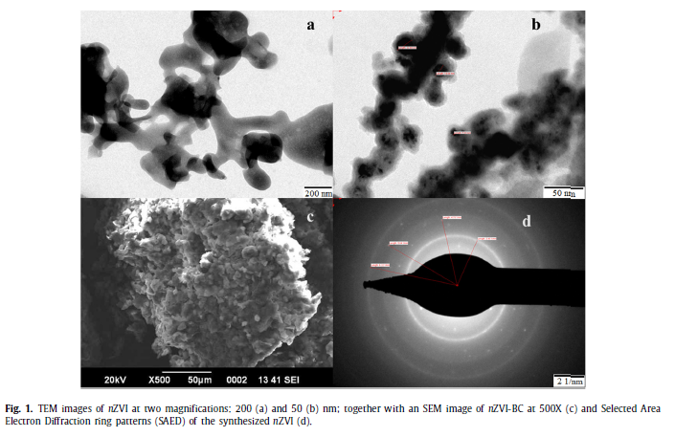
The adsorption of organics, however, is quite different. The organic compounds present in water can be polar or non-polar so that not only electrostatic interactions but also dispersive interactions will play an important role.
In addition the porous structure of the carbon surface which includes the existence of mesopores shall also be an important factor for the adsorption of essentially non-polar organic molecules.

Slide 8

Ammonia Stripping
Ammonia stripping is a simple desorption process used to lower the ammonia content of a wastewater stream.
Ammonia (a weak base) reacts with water (a weak acid) to form ammonium hydroxide. In ammonia stripping, lime or caustic is added to the wastewater until the pH reaches 10.8 to 11.5 standard units which converts ammonium hydroxide ions to ammonia gas according to the following reaction(s):

Slide 9
Advantages
The operation is relatively simple and not affected by wastewater fluctuation if pH and air temperature remain stable.
Ammonia stripping is a mechanical procedure and creates no backwash or regeneration.
Ammonia stripping is unaffected by toxic compounds that could disrupt the performance of a biological system.
Ammonia stripping is a controlled process for selected ammonia removals.
Disadvantages
Water must be re-pumped to the stripping tower. Pumping requires higher maintenance and power requirements.
Scale formation can be removed hydraulically in most cases but not all, resulting in a need to pilot test at most locations.
Ammonia stripping cannot be performed in freezing conditions (unless sufficient heated air is available). Fogging and icing result in a significant reduction in ammonia removal.
While ammonia is usually discharged to the atmosphere at low level (6 mg/m3 ), this may be unacceptable in certain locations due to air quality concerns or regulations.
Ammonia stripping does not remove nitrite and organic nitrogen.
Air stripping often requires the addition of lime to control pH, which may create operation and maintenance concerns.
Noise may be a problem.

Slide 10
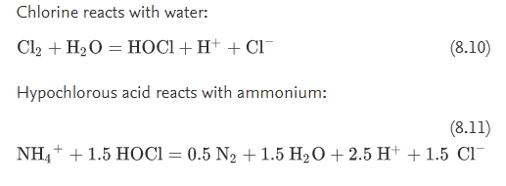
Breakpoint chlorination to remove ammonia
The most common method used for ammonia removal is ‘breakpoint’ chlorination where ammonia nitrogen is completely oxidized to nitrogen leaving a residual of free chlorine.
Breakpoint chlorination method is to add certain amount of chlorine gas or sodium hypochlorite into the wastewater to oxidize NH₄⁺ to N₂. The reaction is as follows:
Chlorine reacts with water:
When chlorine is added to certain dosage, the breakpoint will occurs on the curve of residual chlorine versus the dosage of the added chlorine. At this point, the concentration of chlorine in the treating wastewater is lower, and NH₄⁺ in the treated water goes to zero. When the dosage of added chlorine is more than this point, the chlorine in the treated wastewater will be increased. This point is called the breakpoint.

Slide 11
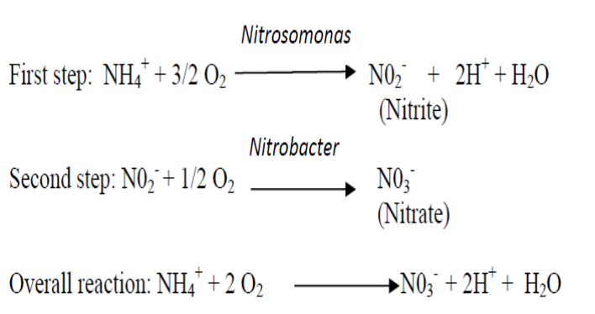
Biological Nitrification and Denitrification

Slide 12
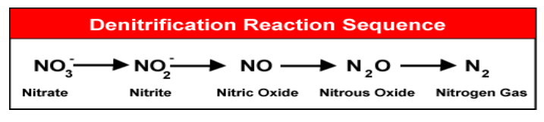

Denitrification occurs when oxygen levels are depleted and nitrate becomes the primary electron acceptor source for microorganisms.
Denitrification process requires the following:
 Denitrifying bacteria
 Carbon source
 Oxygen source

Slide 13
Phosphorus removal
Phosphorus in waste exists in three forms :
ortho-phosphate (H₃PO₄)
polyphosphate and (H₄P₂O₇ )
organic phosphate (ATP, ADP)
Could be done thru:
Chemical Precipitation
Biological Phosphorus Removal

Slide 14
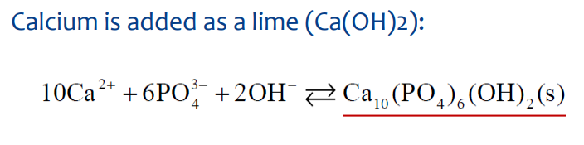
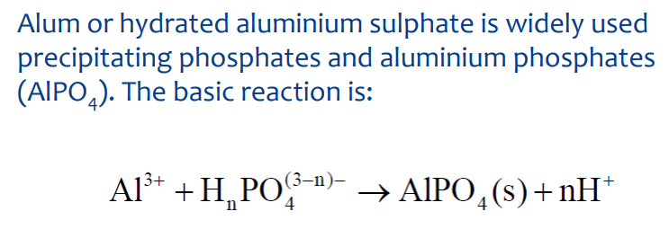
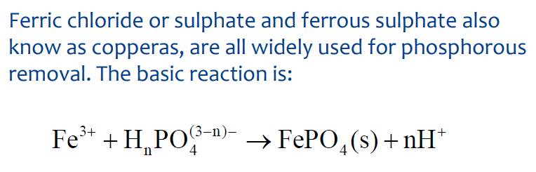
Chemical precipitation is used to remove the inorganic forms of phosphate by the addition of a coagulant to wastewater .The multivalent metal ions most commonly used are:

Slide 15
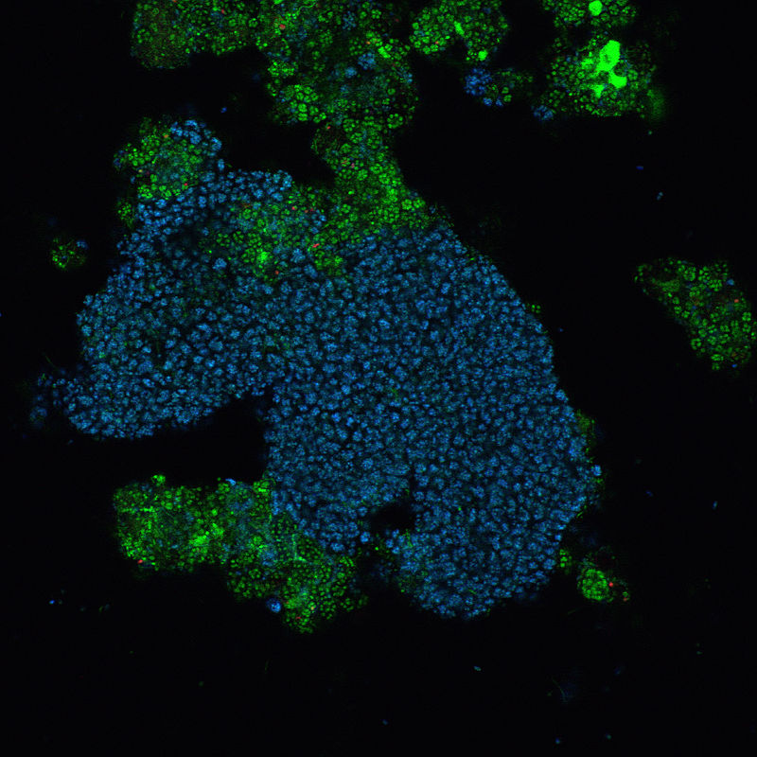
Biological Phosphorus removal
Polyphosphate-accumulating organisms (PAOs) are a group of bacteria that, under certain conditions, facilitate the removal of large amounts of phosphorus from wastewater in a process, called enhanced biological phosphorus removal (EBPR). PAOs accomplish this removal of phosphate by accumulating it within their cells as polyphosphate.
A PAO related to the Betaproteobacteria has been identified and named Candidatus Accumulibacter Phosphatis
It can consume a range of carbon compounds, such as acetate and propionate, under anaerobic conditions and store these compounds as polyhydroxyalkanoates (PHA) which it consumes as a carbon and energy source for growth using oxygen or nitrate as electron acceptor.

Slide 16
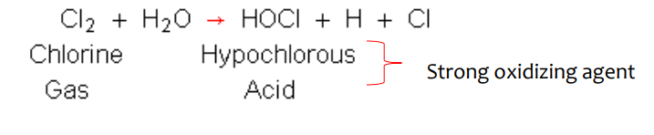
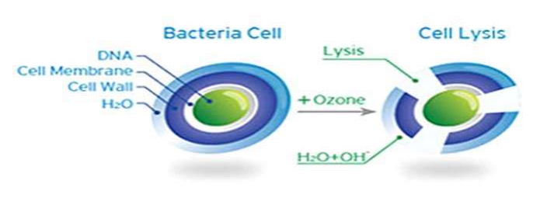
Other treatments - Disinfection
Chlorination
Chlorine disinfection works through oxidation of cell walls leading to cell lysis (bacterial) or inactivation of functional sites on the cell surface
Ozone gas (03) can be used as a disinfectant even though it does not leave a residual in the water being treated.

Slide 17
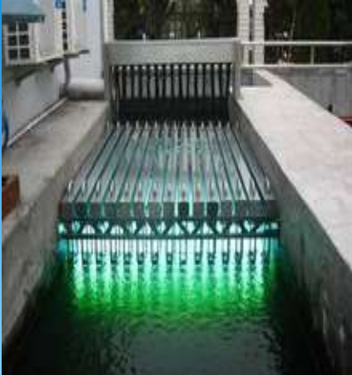
UV Radiation Involves passing a film of wastewater within close proximity of a UV source (lamp)
Damage the genetic structure of bacteria, viruses and other pathogens.

